Slide 1


insurance analytics
TEAM MEMBERS :
Gargi Tiwari
Sushmitha B S
Hitesh S
Madanu Pranay Theja
D Bindu

Slide 2
code: p690 INSURANCE ANALYTICS GROUP -2
TEAM MEMBERS :
Gargi Tiwari
Sushmitha B S
Hitesh S
Madanu Pranay Theja
D Bindu

Slide 3
INTRODUCTION:
In the rapidly evolving insurance industry, the ability to effectively analyze employee performance is crucial for driving efficiency and optimizing operational processes. This project focuses on leveraging data analytics to evaluate and improve the performance of employees within the organization.

Slide 4
PRIMARY GOAL OF THIS PROJECT :
Identify insights and trends that can help improve the overall performance of an employees.
Identifying top–performing employees.
Identifying bottom –performing employees.

Slide 5
Working on raw datasets :
Import files: Brokerage , Individual Budgets, Invoice, Meeting ,Opportunity, Fees.
Remove duplicates :The datasets has underlying duplicates and null which drop through Power BI.
Manage Relation among dataset: with the power pivot and power query use a data model to manage the relationship between all the files.
Prepare Data for Analysis : After cleaning ,removing duplicates and managing relation , calculate some measure and KPI’s for Visualization.

Slide 6
KPI’S :
No of Invoice by Account Exec
Yearly Meeting Count
Calculate Cross Sell—Target, Achieved, Invoice
Calculate New-Target, Achieved , Invoice
Calculate Renewal-Target, Achieved , Invoice
Stage Funnel by Revenue
No of meeting By Account Exe
Top Open Opportunity

Slide 7
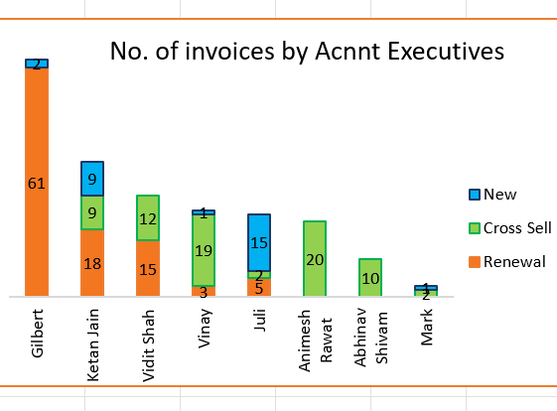
KPI 1:
No of Invoice by Account Exec

Slide 8
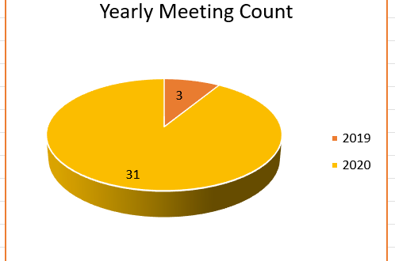
KPI 2:
Yearly Meeting Count.

Slide 9
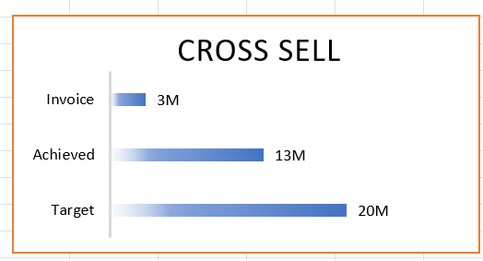
KPI 3(1):
Cross Sell--Target, Achieved, Invoice

Slide 10
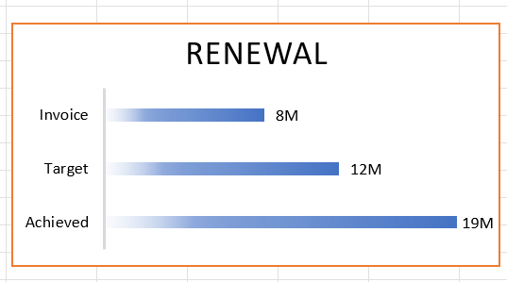
KPI 3(2) :
Renewal-Target, Achieved ,Invoice

Slide 11
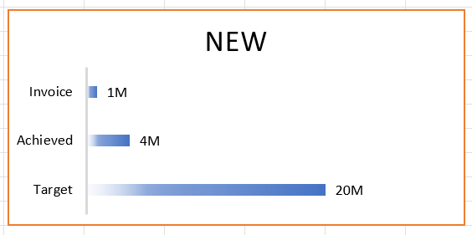
KPI 3(3) :
New-Target ,Achieved ,Invoice

Slide 12
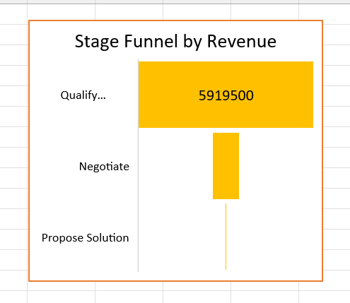
KPI 4 :
Stage Funnel by Revenue

Slide 13
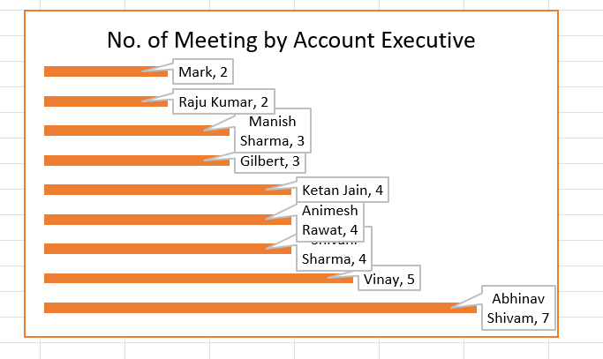
KPI 5 :
No of meeting By Account Exe

Slide 14
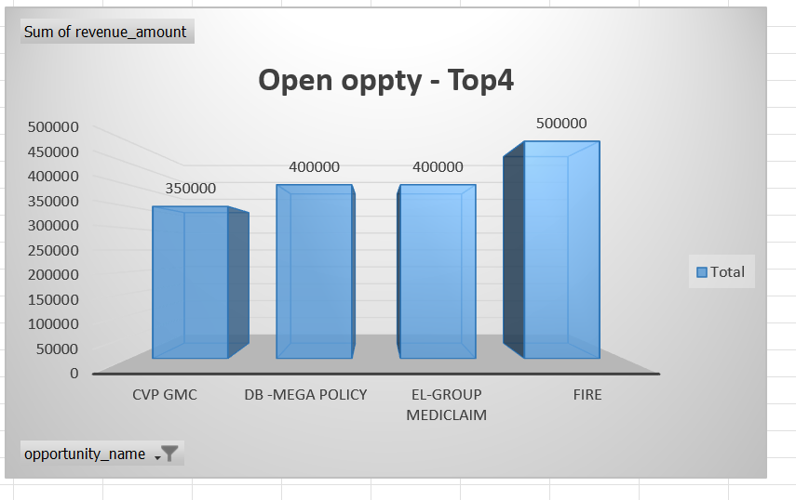
KPI 6:
Top Open Opportunity

Slide 15
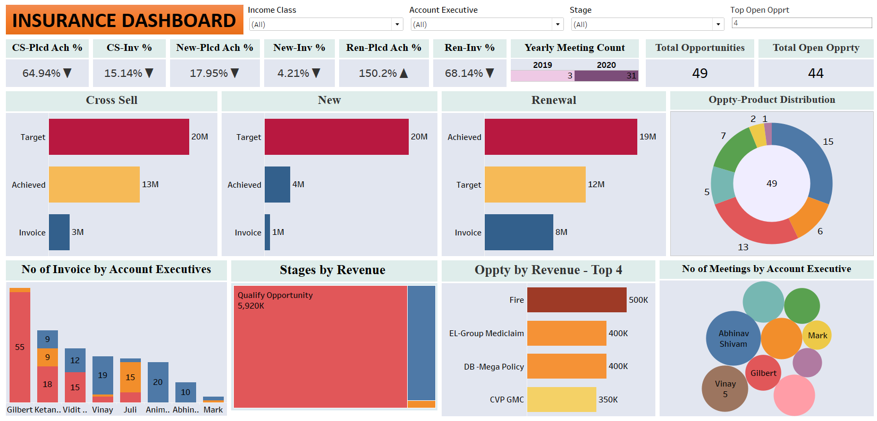
DASHBOARD TABLEAU

Slide 16
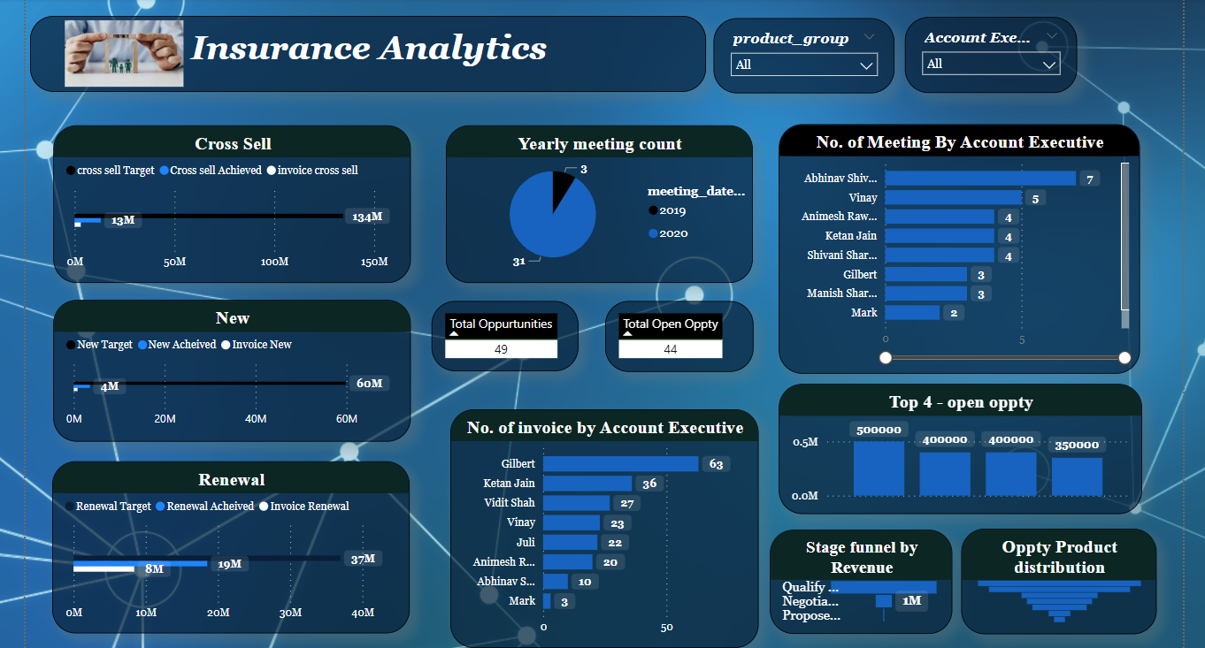
DASHBOARD POWER BI

Slide 17
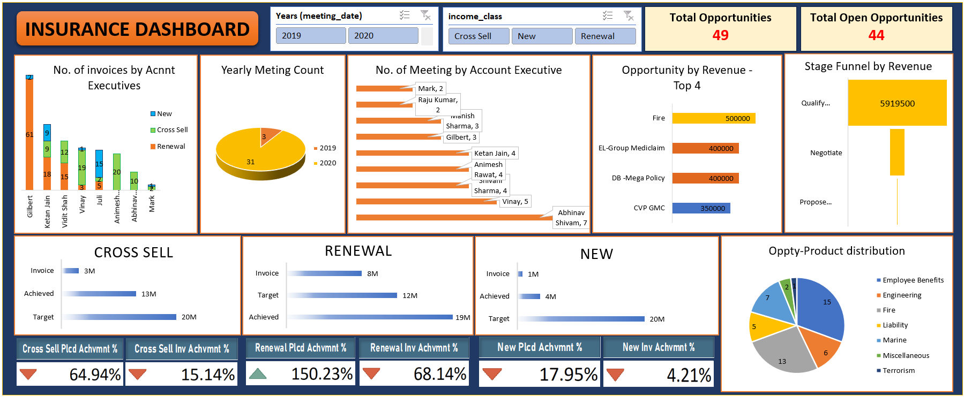
DASHBOARD EXCEL

Slide 18
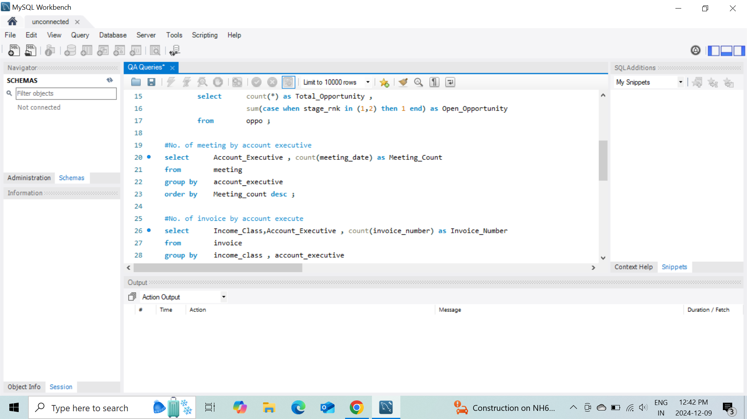
mysql queries screenshot

Slide 19
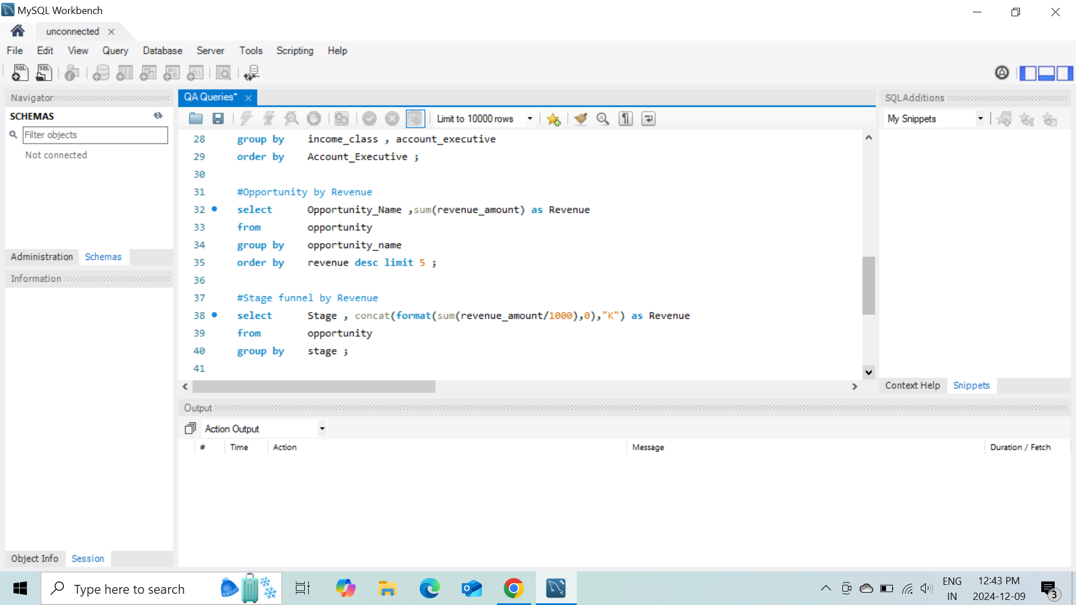
mysql queries screenshot

Slide 20
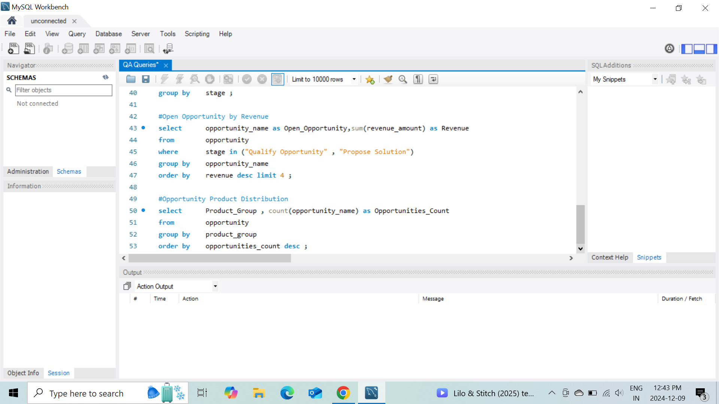
mysql queries screenshot

Slide 21
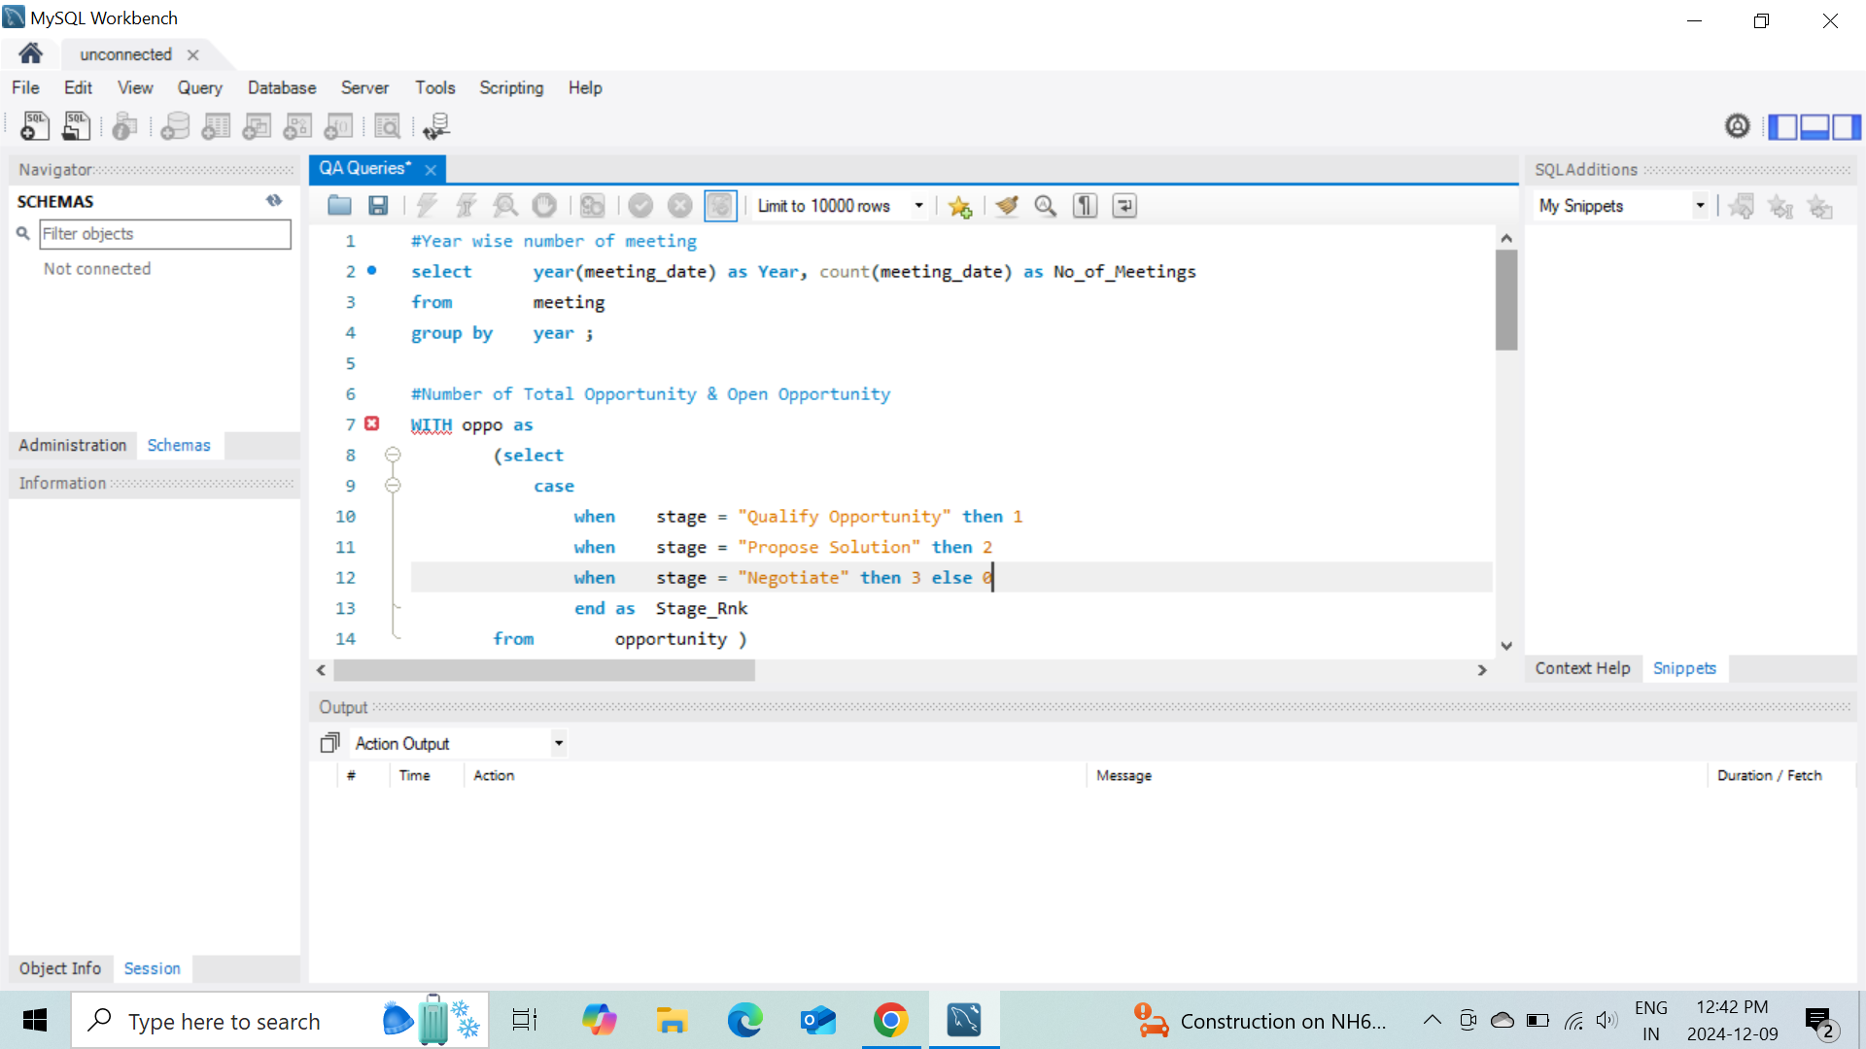
mysql queries screenshot

Slide 22
QUICK ANALYSIS :
By systematically analyzing employee performance using data-driven approaches, the project aims to foster a culture of continuous improvement, ultimately benefiting both employees and the organization as a whole. This analysis can lead to informed decisions that enhance productivity and customer satisfaction in the competitive insurance market.

Slide 23


